Slide 1

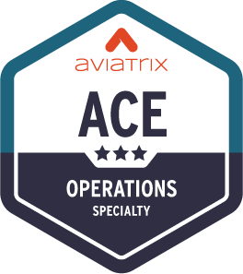
Routes Manipulation & NAT

Slide 2
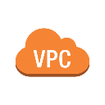


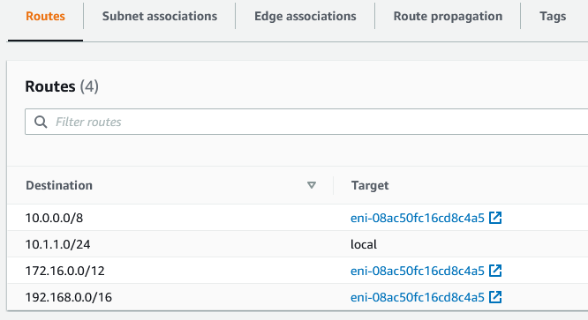
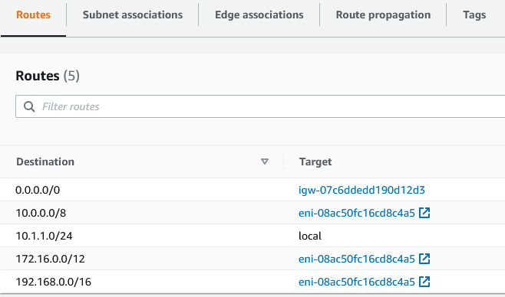


RFC1918 Routes Injection = Standard behavior of the Controller
As soon as the Controller completes the deployment of the attachments between Spoke Gateways and Transit Gateways, it will also program the three RFC1918 routes in the route tables to point to the ENI of the Spoke Gateways.
APPLICATIONS LAYER
Spoke VPC 1
Spoke VPC 2
Route table for Private Subnet
Route table for Public Subnet
Transit VPC
OPERATIONS

Slide 3
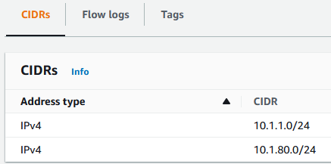
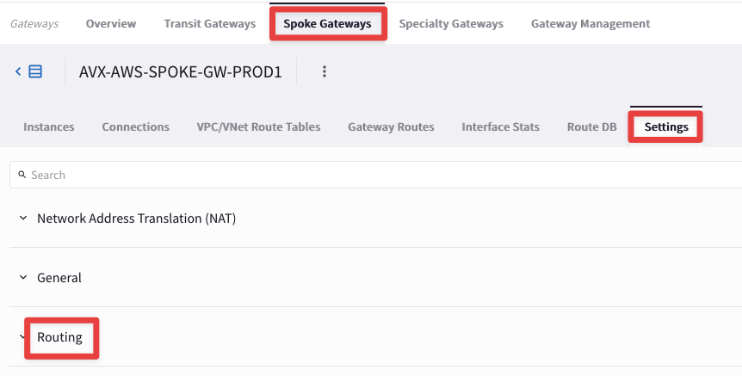
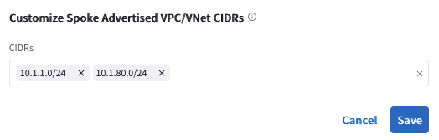
Routes Manipulation – Customize Spoke Advertised VPC CIDRs
For example, if you decide to add another CIDR block to an existing VPC, in that case you can also advertise the new CIDR within your MCNA.
APPLICATIONS LAYER
Spoke VPC 1
Spoke VPC 2
PATH: COPILOT > Cloud Fabric > Gateways > Spoke Gateways > select the relevant GW > Settings > Routing > Customize Spoke Advertised VPC/VNet CIDRs
10.1.1.0/24
10.1.80.0/24
Transit VPC
OPERATIONS
This feature affects the Spoke-Transit routes advertisement

Slide 4
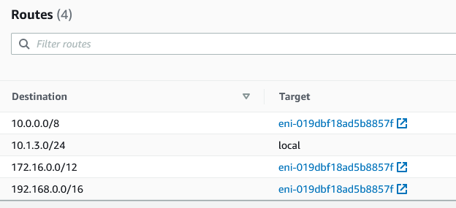
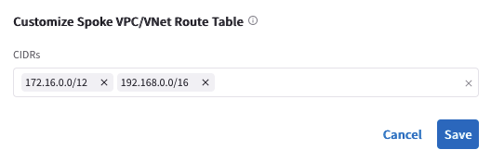
Routes Manipulation – Customize Spoke VPC Routing Table
You can also decide to withdraw an RFC1918 route that was previously injected by the Controller, customizing the VPC/Vnet/VCN routing table.
APPLICATIONS LAYER
Spoke VPC 1
Spoke VPC 2
PATH: COPILOT > Cloud Fabric > Gateways > Spoke Gateways > select the relevant GW > Settings > Routing > Customize Spoke VPC/VNet Route Table
Transit VPC
OPERATIONS
This feature affects the routes installed inside the VPC/Vnet/VCN routing tables.

Slide 5
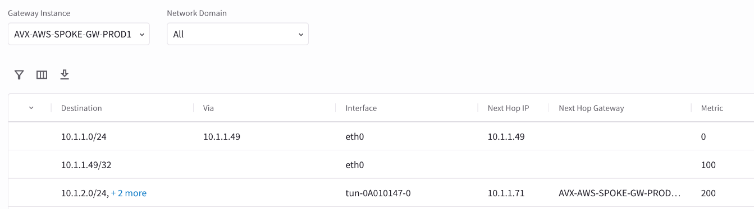
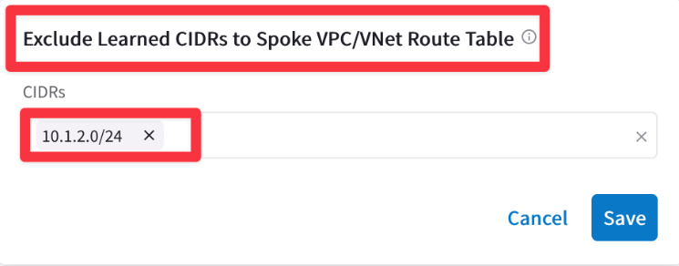
Routes Manipulation – Exclude Learned CIDRs to Spoke VPC/VNet Route Table
You can also decide to filter out a route from the routing table of a Spoke GW.
APPLICATIONS LAYER
Spoke VPC 1
Spoke VPC 2
10.1.1.0/24
10.1.2.0/24
PATH: COPILOT > Cloud Fabric > Gateways > Spoke Gateways > select the relevant GW > Settings > Routing > Exclude Learned CIDRs to Spoke VPC/Vnet Route Table
10.1.2.0/24
NOT installed
Transit VPC
OPERATIONS

Slide 6
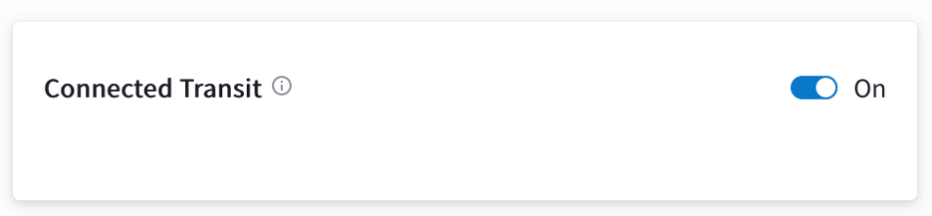
Routes Manipulation – Connected Transit
By default, Aviatrix Spoke VPCs/VNets do not have routing established to communicate with each other via Transit. They are completely segmented.
Each Spoke VPC should be connected to its own dedicated Transit VPC.
If you would like to build a full mesh network where Spoke VPCs/VNets communicate with each other via Transit GW, you can achieve that by enabling Connected Transit mode.
APPLICATIONS LAYER
APPLICATIONS LAYER
Spoke VPC 1
Spoke VPC 2
Spoke VPC 1
Spoke VPC 2
Transit VPC
Transit VPC
Transit VPC
OPERATIONS
OPERATIONS

Slide 7
NAT - Overview
The Aviatrix Spoke Gateways provide advanced NAT capabilities.
Three NAT functions are supported:
Source NAT:
Two modes of Source NAT are supported:
Single IP
Customized SNAT
Destination NAT
Mapped NAT

Slide 8
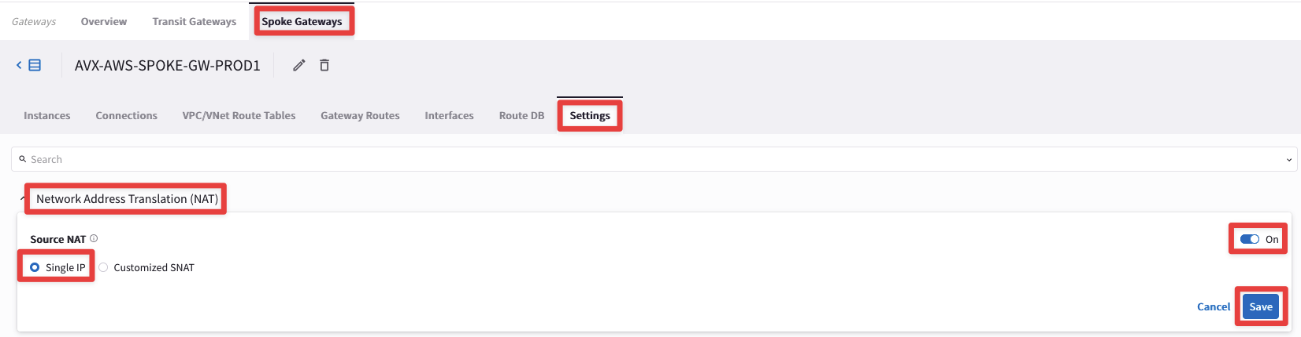
Source NAT: Single IP
PATH: COPILOT > Cloud Fabric > Gateways > Spoke Gateways > select the relevant gateway > Settings > NAT
In addition to the RFC1918 routes, the Controller will also install a quad zero route that points to the ENI of the Spoke Gateway.

Slide 9
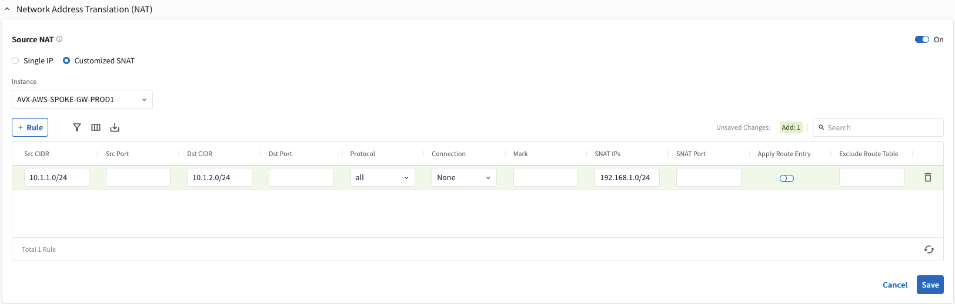
Source NAT: Customized SNAT
When Customized SNAT is selected, the gateway can translate source IP address ranges to different SNAT address and ports.

Slide 10
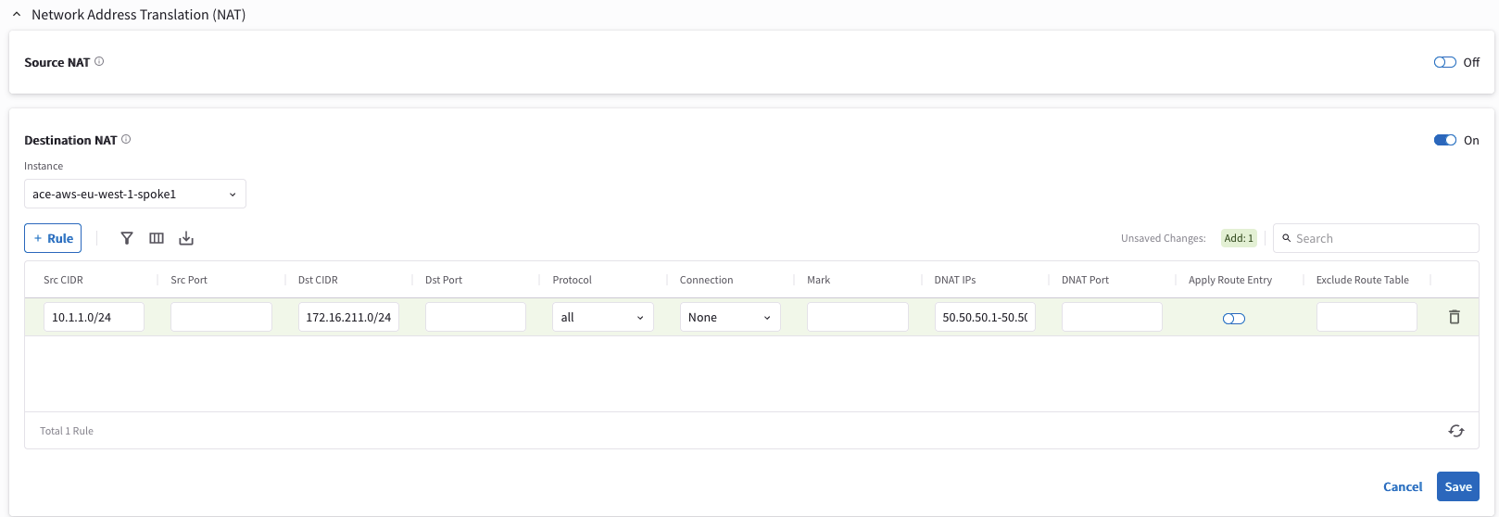
Destination NAT
Destination NAT (DNAT) allow you to change the destination to a virtual address range.

Slide 11
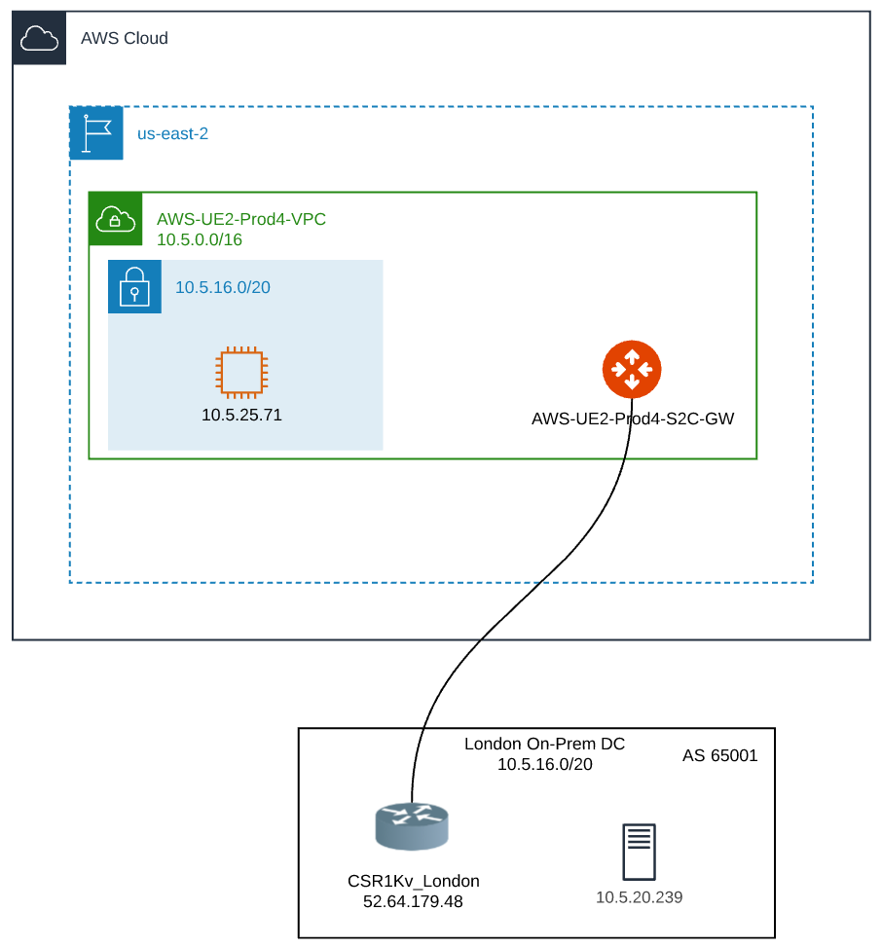
Mapped NAT - Overview
Need to connect overlapping networks between the cloud and on-prem
Don’t want the on-prem router to implement any NAT
Keep it simple with no on-prem dependency
Many on-prem routers have no NAT, or very limited NAT
The host information must be preserved
No NAT overload requirement anywhere
The configuration must be simple and scalable

Slide 12
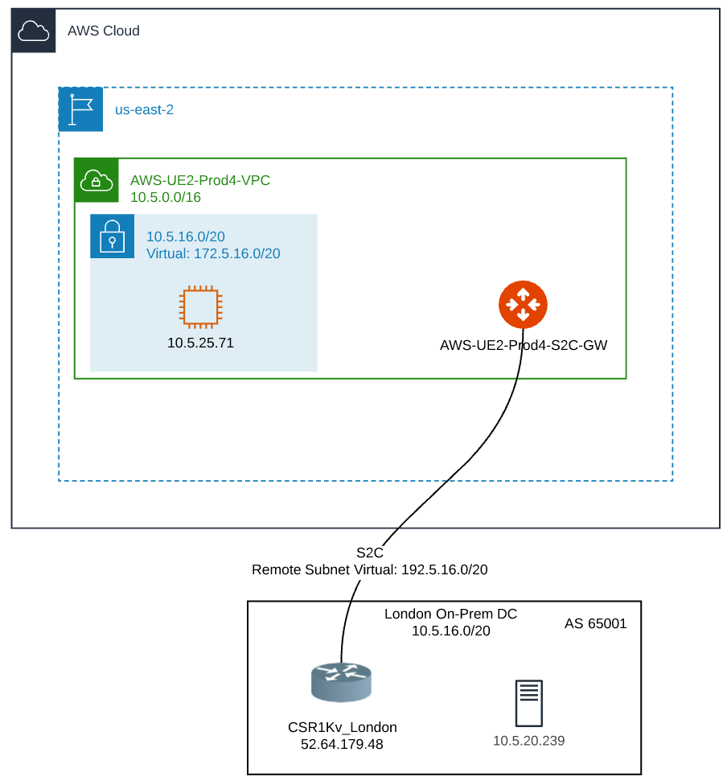
Mapped NAT – Virtual Subnets
Virtual subnets, which are defined to be unique (not necessarily RFC1918), are used for communication between overlapping VPC and on-prem
The Site2Cloud Gateway NATs between real subnets and virtual subnets, while preserving the host information in the IP
There is no need for any on-prem NAT operations
The configuration is extremely simple, and it does not require individual /32 NAT rules
Route-based IPsec is required
Notes:
Policy-Based vs Route-Based IPSec VPNs:
Policy-based VPNs encrypt and encapsulate a subset of traffic flowing through an interface according to a defined policy (an access list). The policy may dictate that only some or all of the traffic being evaluated is placed into the VPN. This type of VPN is often referred to as LAN-to-LAN
In contrast to a policy-based VPN, a route-based VPN employs routed tunnel interfaces as the endpoints of the virtual network. All traffic passing through a tunnel interface is placed into the VPN. Rather than relying on an explicit policy to dictate which traffic enters the VPN, static and/or dynamic IP routes are formed to direct the desired traffic through the VPN tunnel interface.

Slide 13
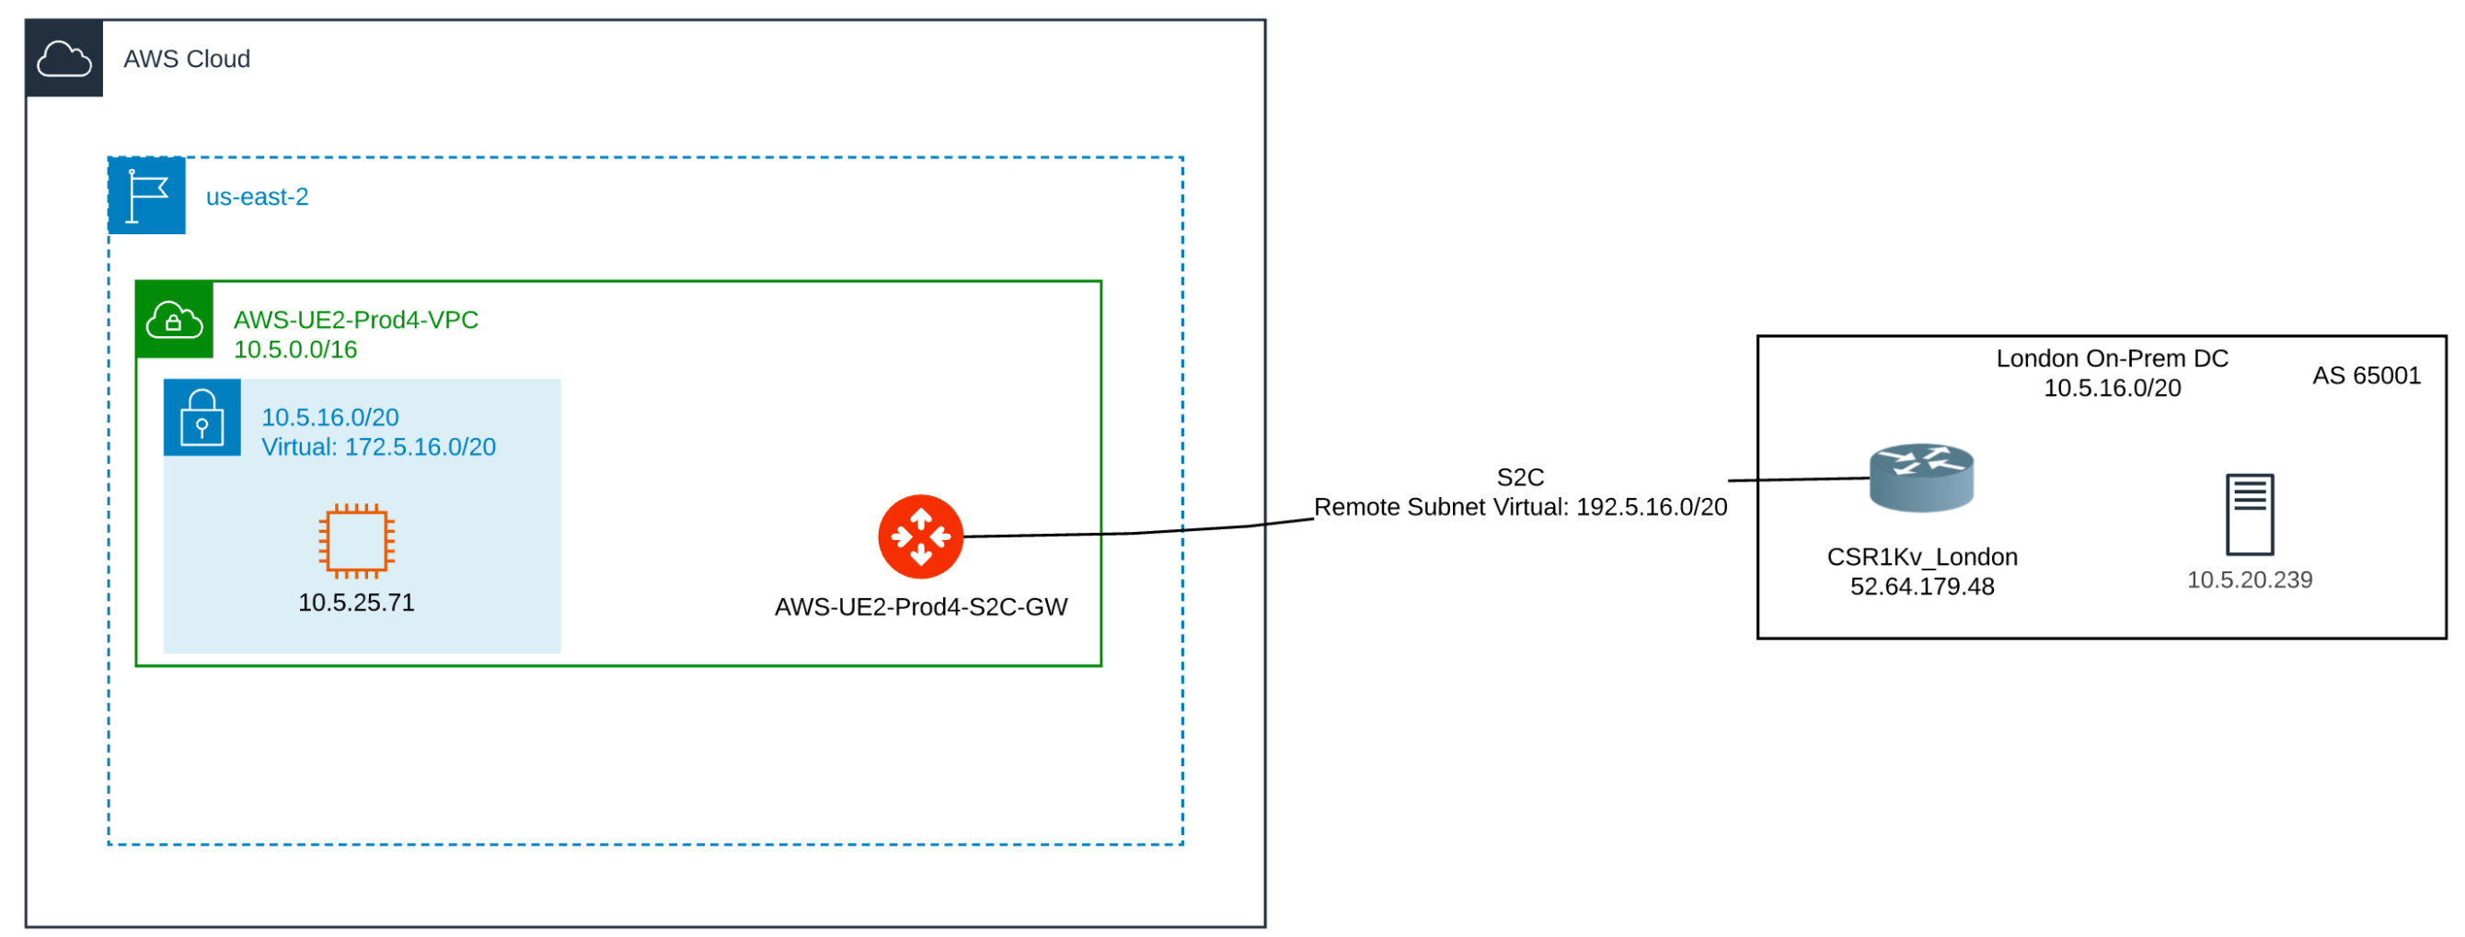
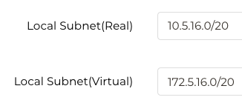
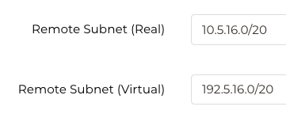
Mapped NAT – Packet Walk (from Local to Remote)
SIP = 172.5.25.71 (no change by on-prem router)
DIP = 10.5.20.239 (no change by on-prem router)
SIP = 172.5.25.71 (SNAT to Local Subnet Virtual by Site2Cloud Gateway)
DIP = 10.5.20.239 (DNAT to Remote Subnet Real by Site2Cloud Gateway)
SIP = 10.5.25.71
DIP = 192.5.20.239

Slide 14
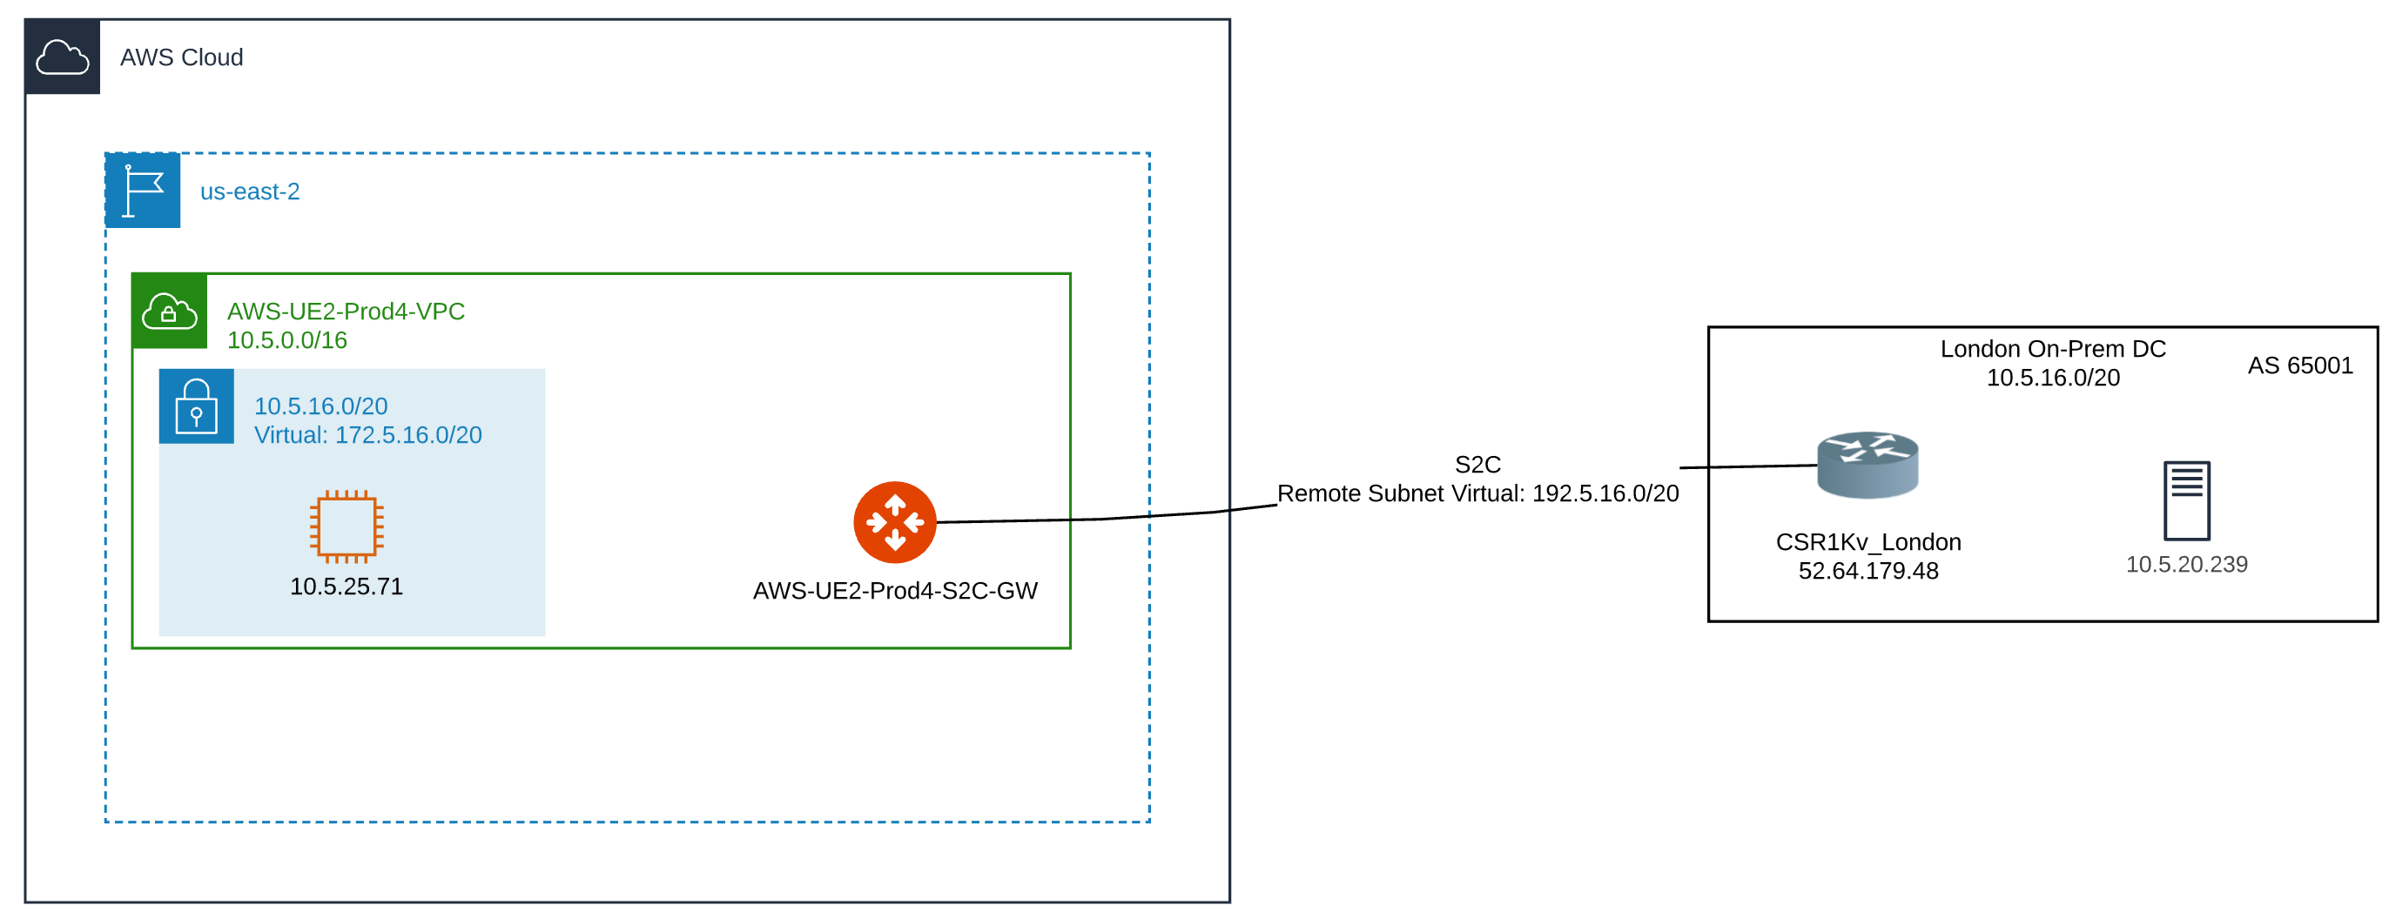
Mapped NAT – Packet Walk (from Remote to Local)
SIP = 10.5.20.239 (no change by on-prem router)
DIP = 172.5.25.71 (no change by on-prem router)
SIP = 192.5.20.239 (SNAT to Remote Subnet Virtual by Site2Cloud Gateway)
DIP = 10.5.25.71 (DNAT to Local Subnet Real by Site2Cloud Gateway)
SIP = 10.5.20.239
DIP = 172.5.25.71

Slide 15
Tools for Operating your Routes Manipulation & NAT

Slide 16
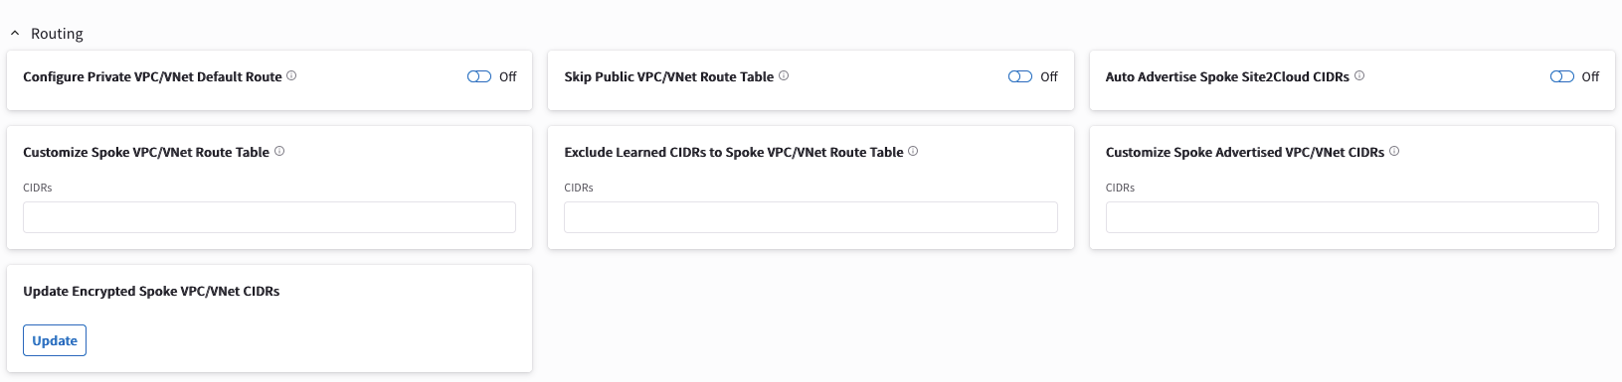
Routes Manipulation - ACTIONS
PATH: COPILOT > Cloud Fabric > Gateways > Spoke Gateways > select the relevant GW > Settings > Routing

Slide 17
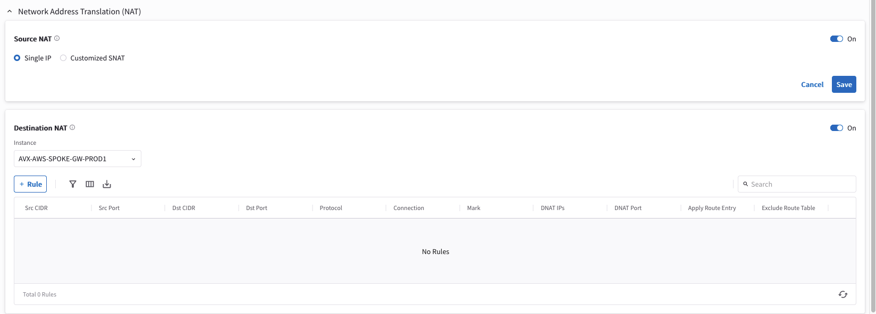
NAT
PATH: COPILOT > AirSpace > Gateways > Spoke Gateways > select the relevant GW > Settings > NAT

Slide 18
Next: Lab 5 Routes Manipulation & NAT

